Slide 1
STATS 765 Project Milestone 4
Measuring the Impact of the 2020 Residential Tenancies Amendment Act
Chase Robertson crob873

Slide 2
Goal
To investigate the impact of the 2020 Residential Tenancies Amendment Bill by observing changing trends on the NZ housing market.

Slide 3
Data Sources
NZ Tenancy Services - 3 datasets
Quarterly suburban bond statistics - 2,000 suburbs
Monthly territorial bond statistics - 66 territories
Monthly regional bond statistics - 16 regions
Stats NZ - 1 dataset
Statistical Areas (2019) - maps Location IDs to Location names

Slide 4
Data Processing
For all three datasets:
Ensure proper data types and address missing values.
Some numerics import as character - remove the thousands-delimiting commas.
Convert `Time Frame` into `date`, `year`, and `month` or `quarter` attributes.
Quarterly dataset only:
Join Location ID and Location names from Stats NZ. Manually add special-case aggregate ID `-99` (Sum of all locations).

Slide 5
Data Exploration
Active Bonds
Across the Nation
Per Region
Per Territory
Total, Lodged, Closed Bonds
Across the Nation
By Dwelling Type

Slide 6
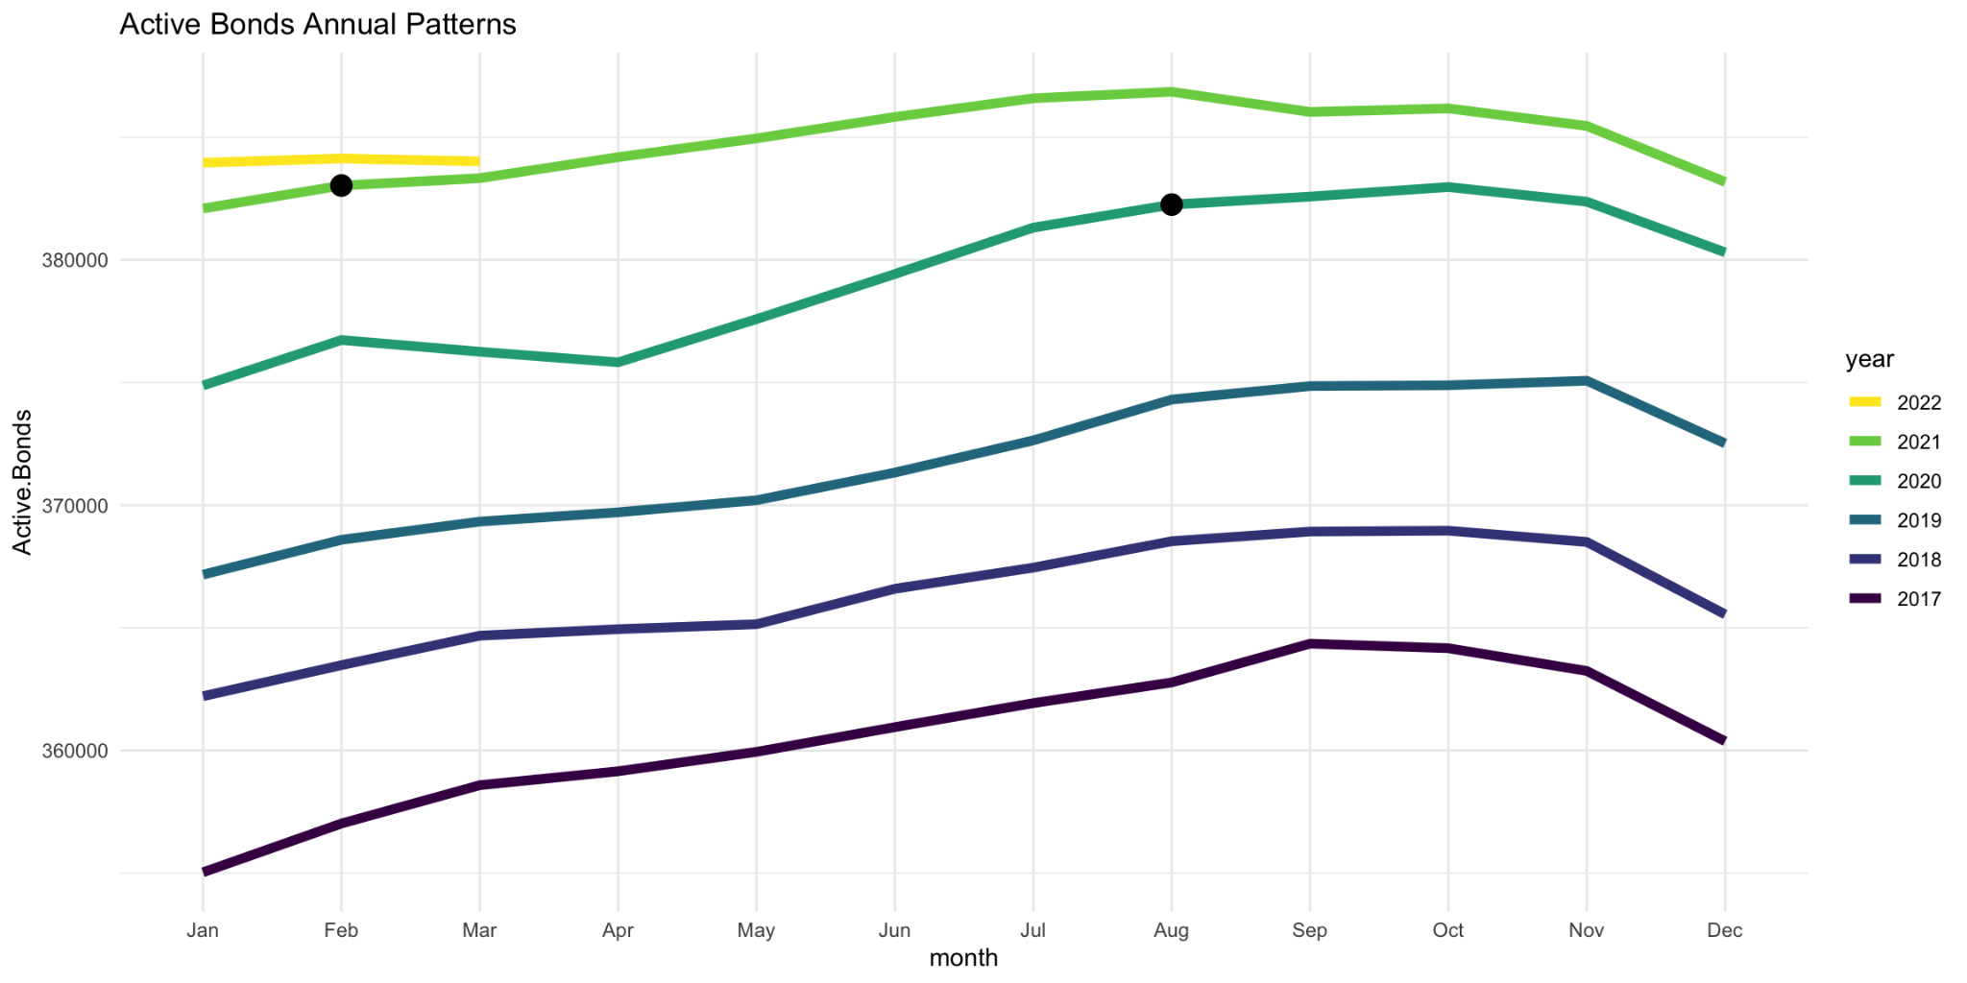
Active Bonds - Across the Nation

Slide 7
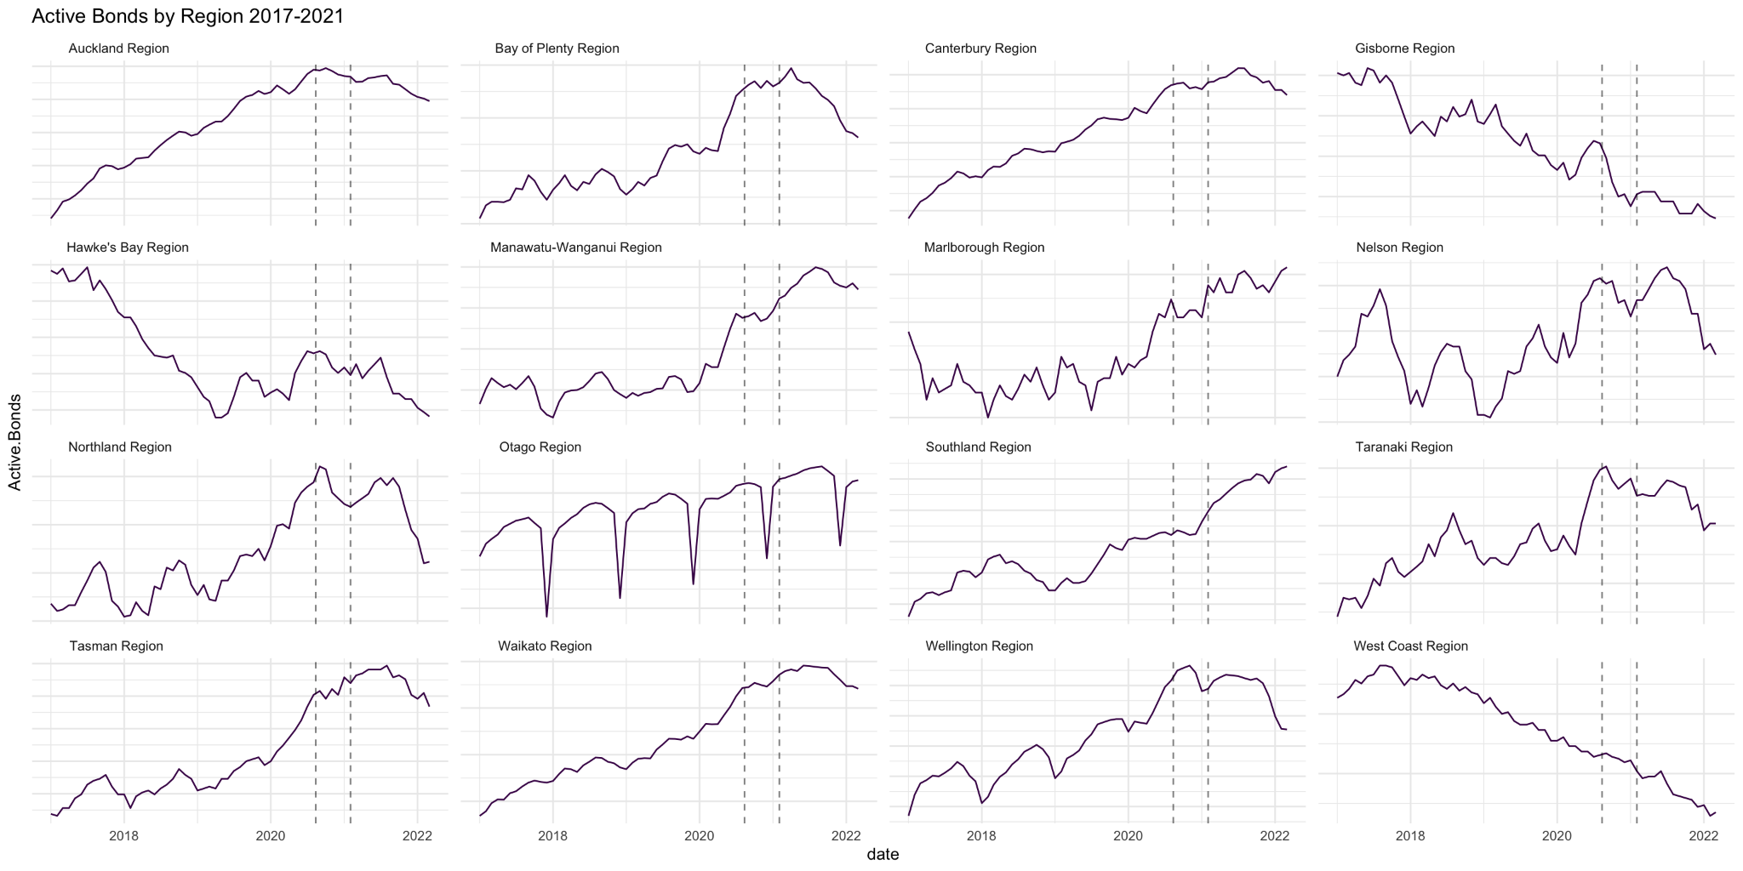
Active Bonds - Per Region

Slide 8
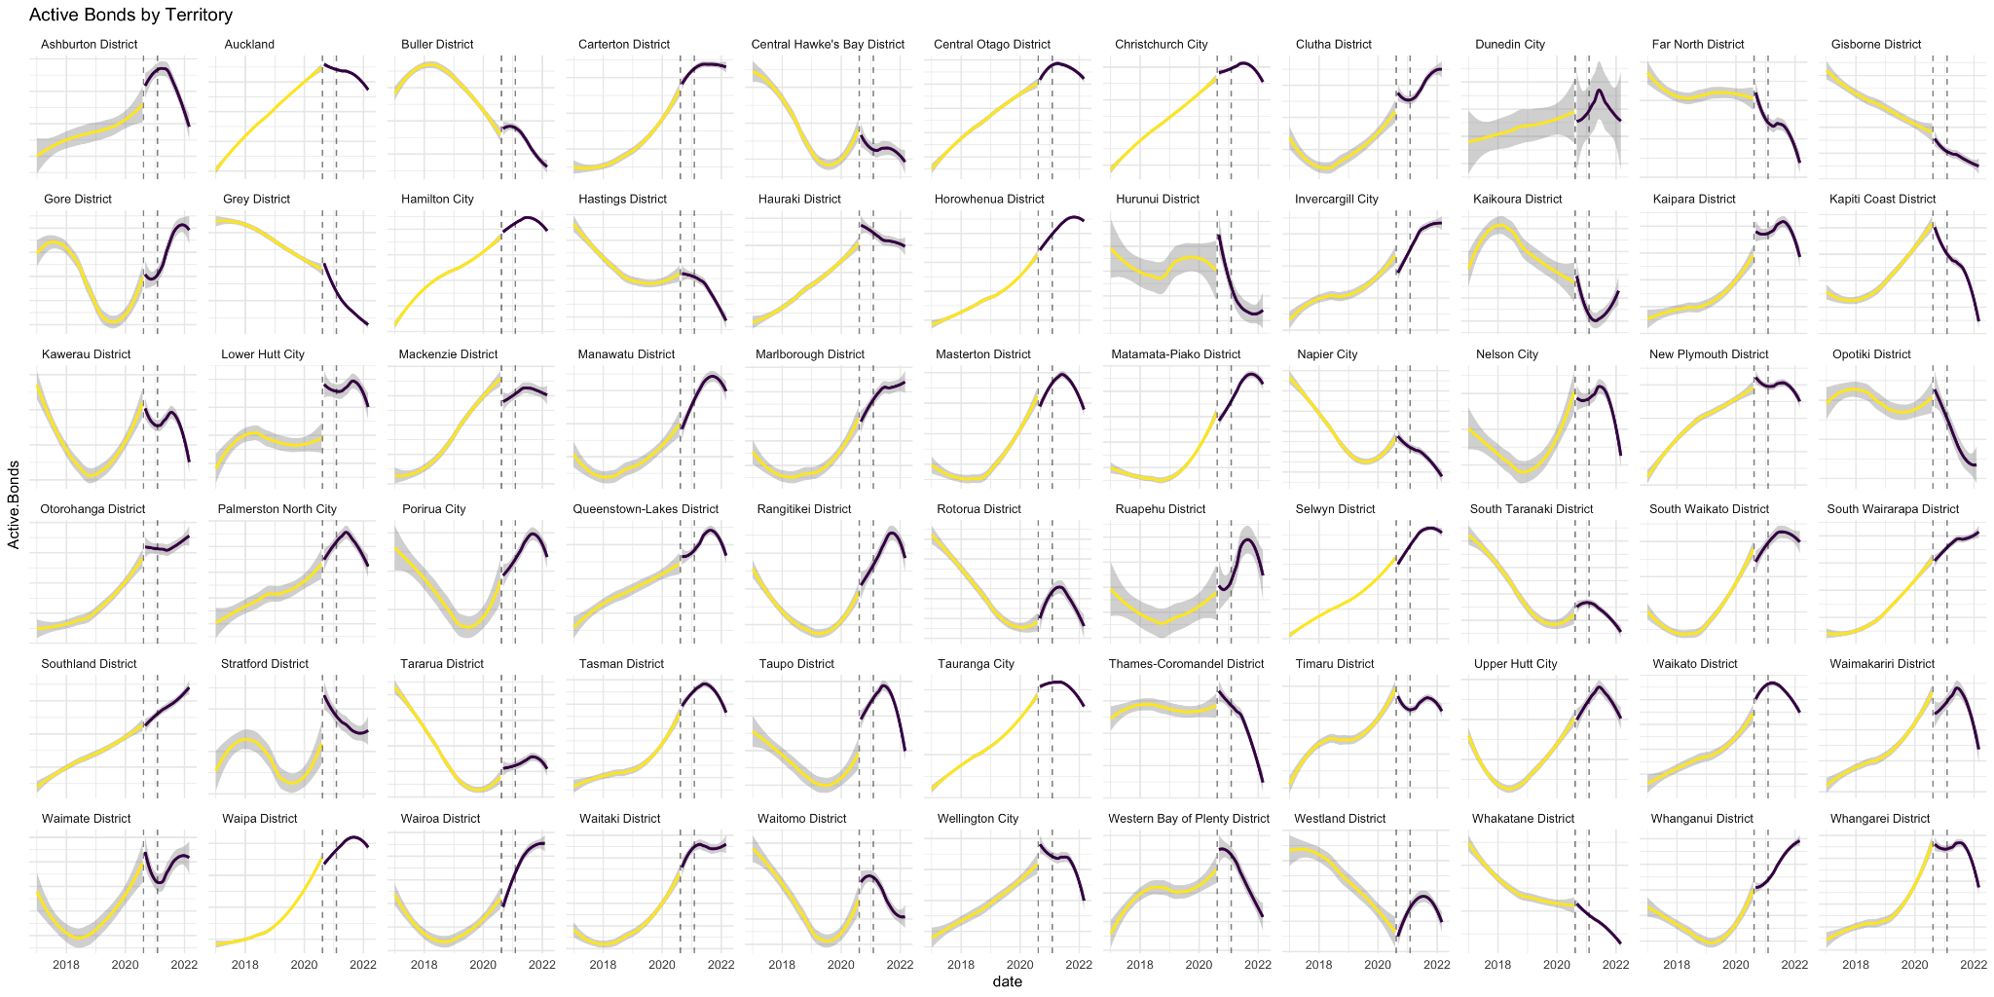
Active Bonds - Per Territory

Slide 9
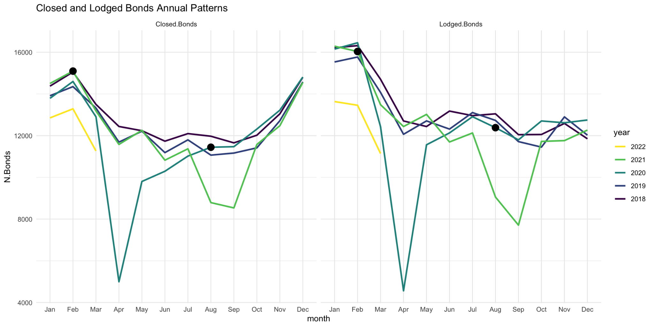
Total vs Lodged Bonds - Across the Nation

Slide 10
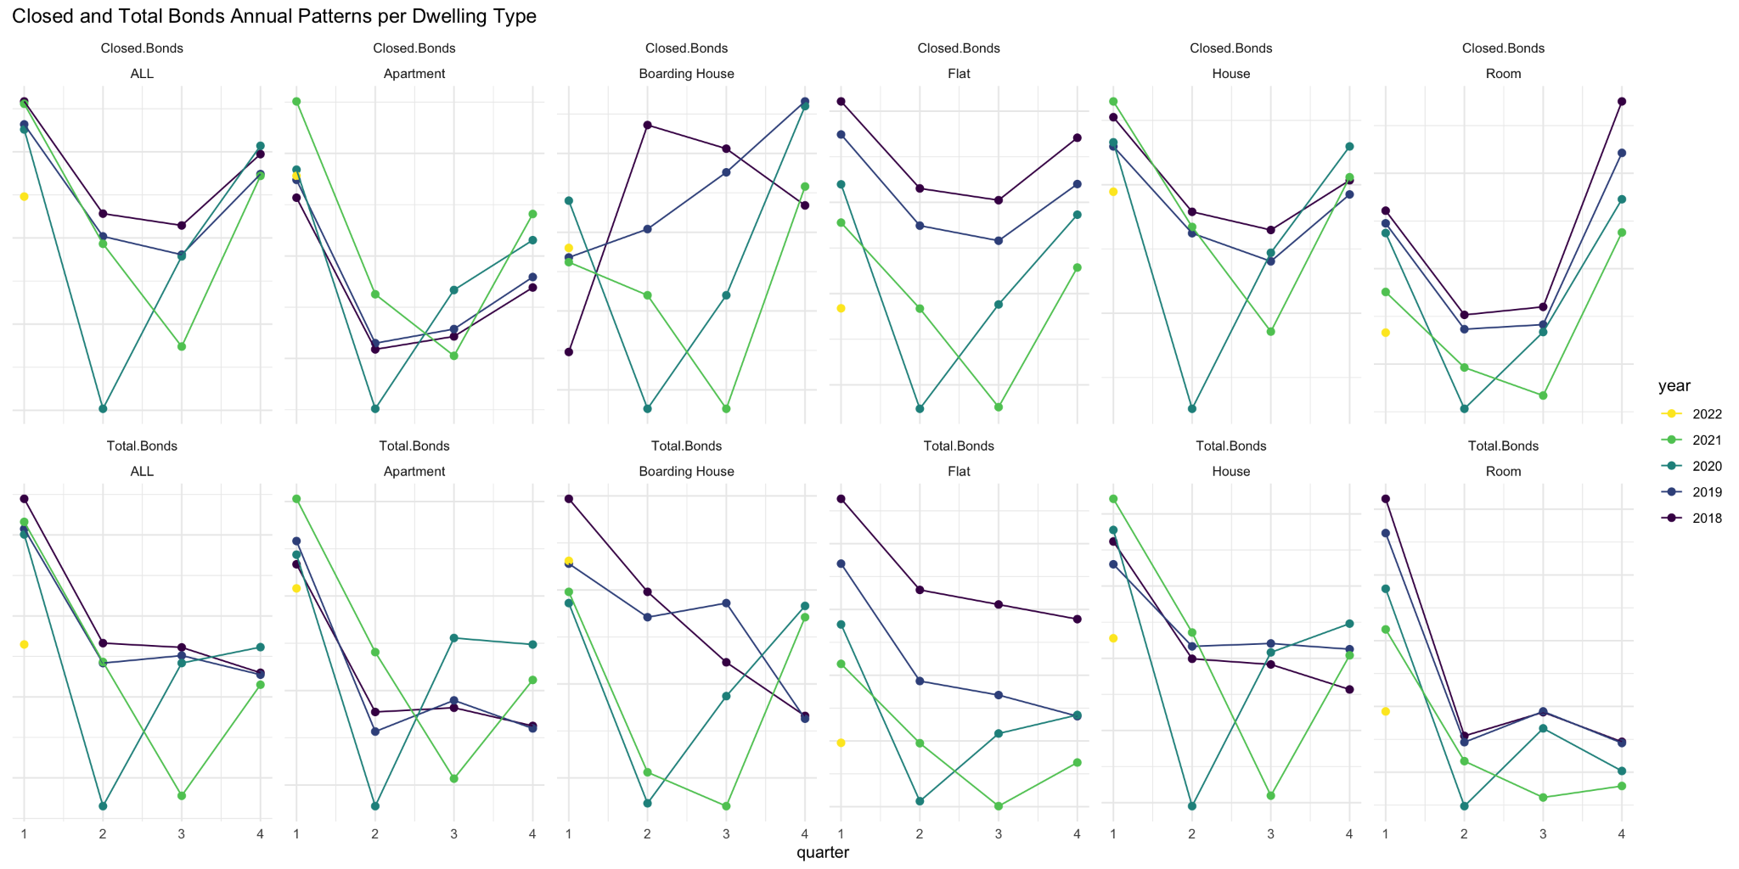
Total vs Closed Bonds - By Dwelling Type

Slide 11
Modeling and Analysis
Random Forest
Location limited to Auckland only:
Seasonal Time-Series Models
Bayesian Structural Time-Series
Month-over-Month Segmented Regression
Changepoint Detection

Slide 12
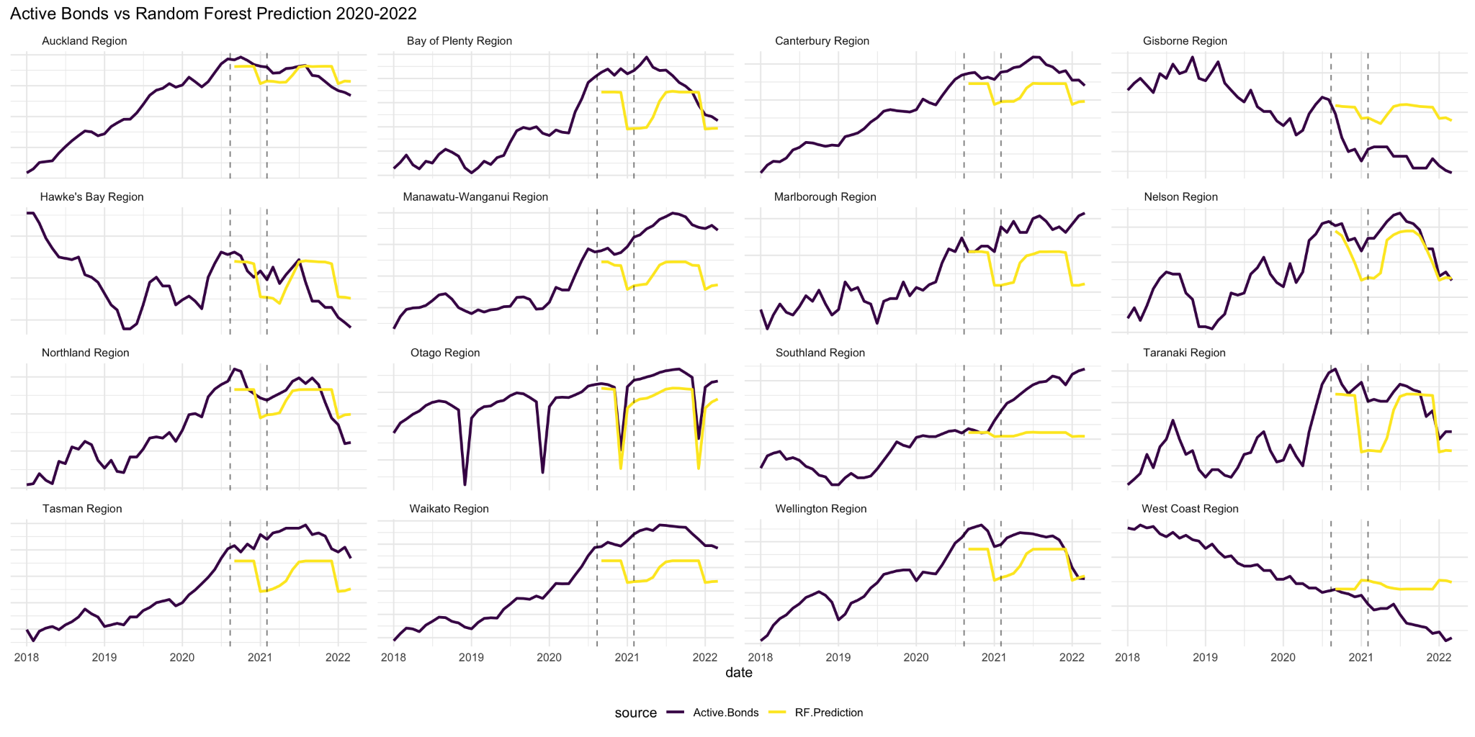
Random Forest

Slide 13
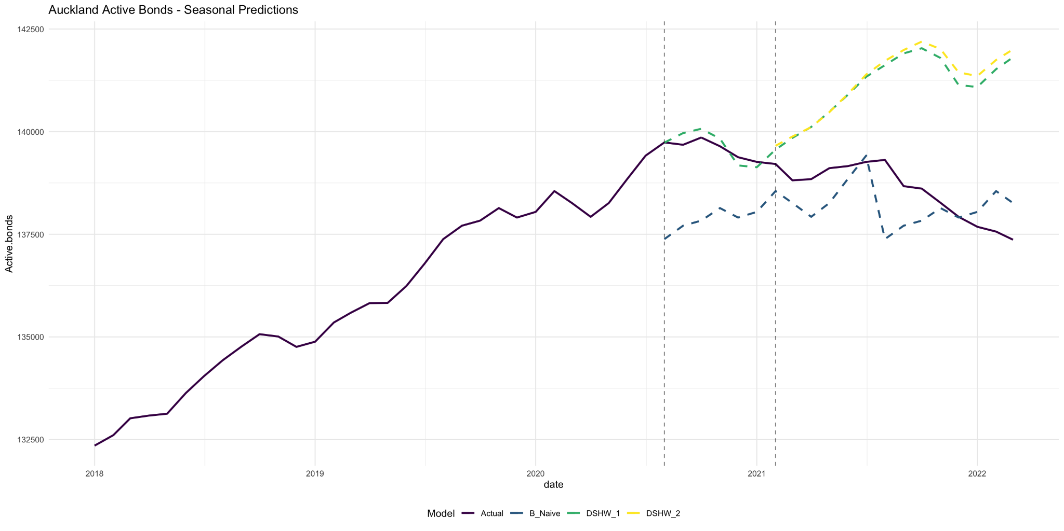
Auckland - Seasonal Time-Series Models

Slide 14
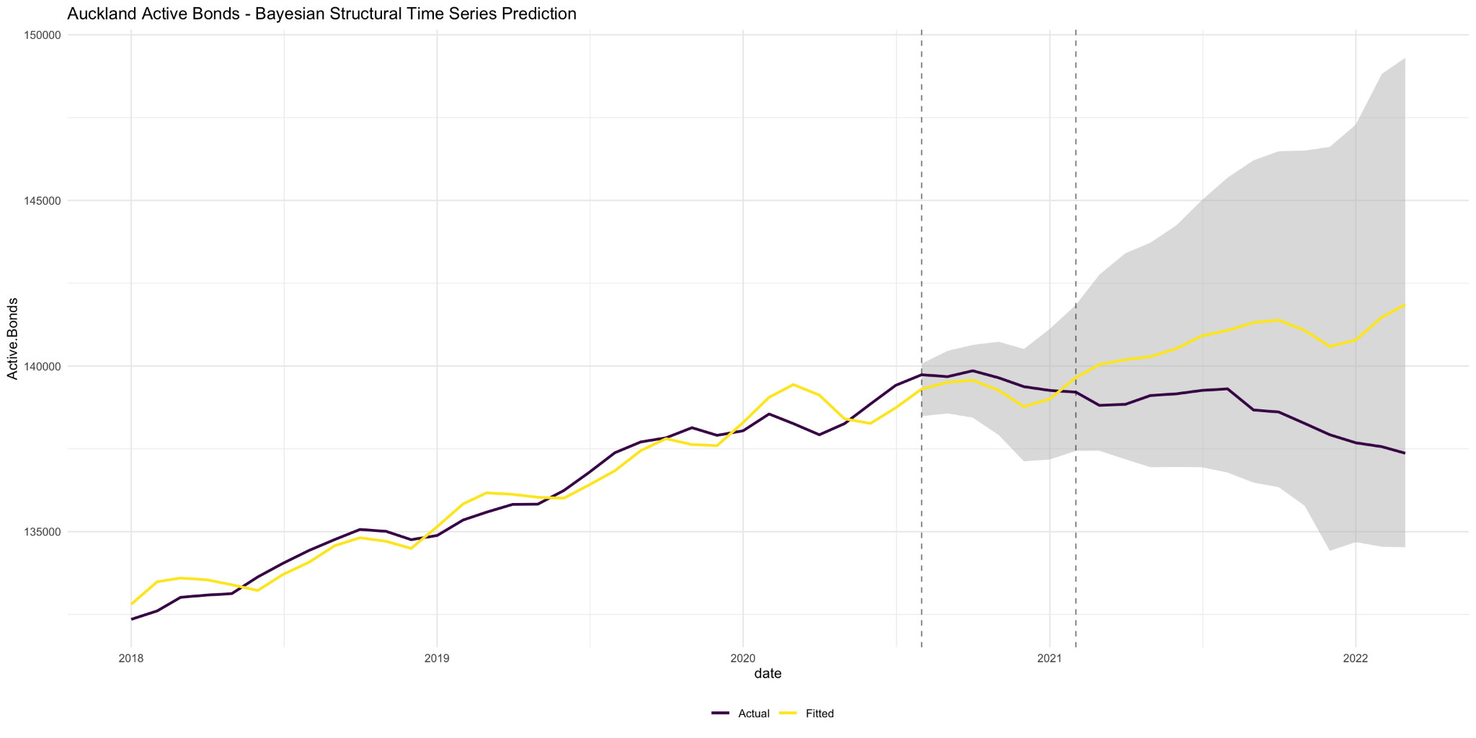
Auckland - Bayesian Structural Time-Series

Slide 15
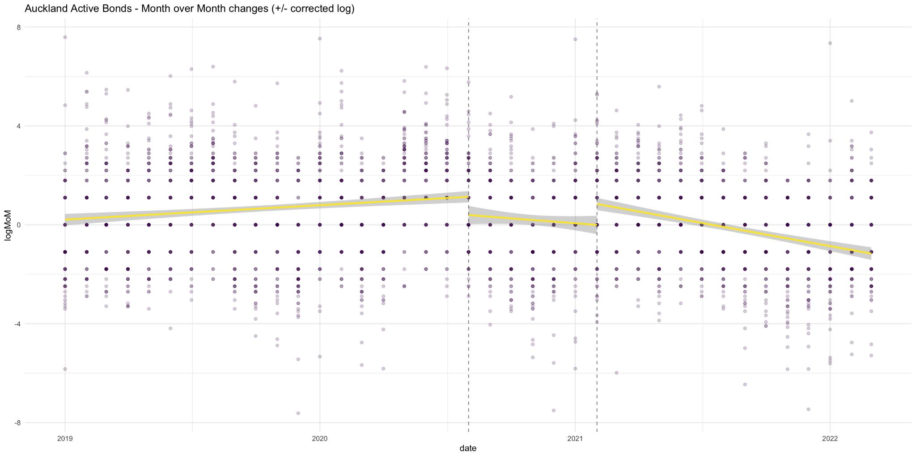
Month-over-Month Segmented Regression

Slide 16
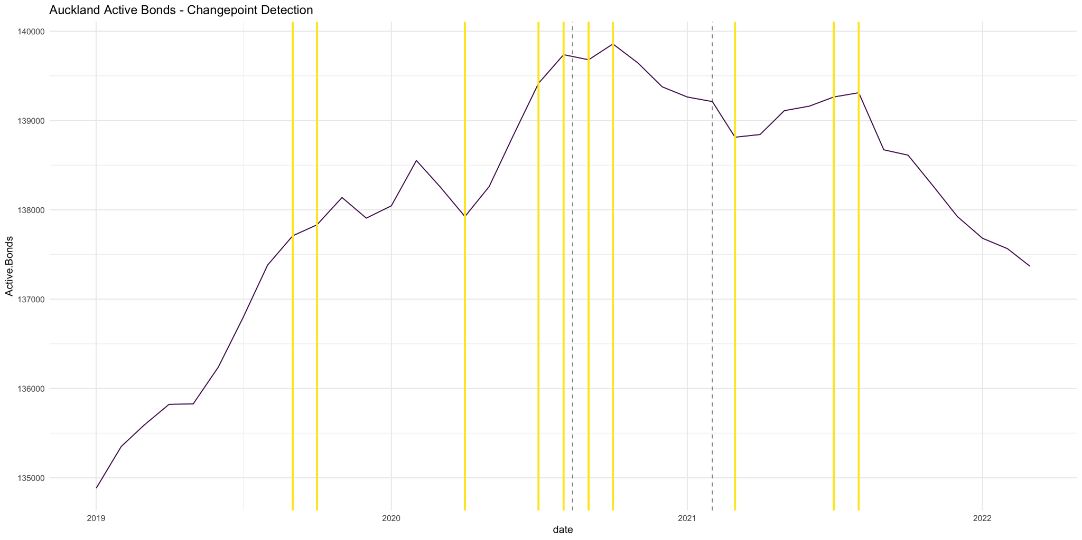
Changepoint Detection

Slide 17
Fin

